Slide 1
The DBLP
Computer Science Bibliography:
Evolution, Research Issues,
Perspectives
SPIRE 2002
Lisbon, Portugal

Slide 2
Thank you for the invitation
Many of you use DBLP
This talk gives some background information about the service
You are invited to use the DBLP data to test and evaluate for your algorithms …

Slide 3
About me …
born March 1959
1986 diploma in informatics from Aachen University of Technology
1993 Ph.D. from University of Trier
since 1993 lecturer at U Trier
  Programming for 1st/2nd year students
  DB implementation, Digital Libraries

Slide 4
Outline
History
Technical Background
Perspectives & Research Issues

Slide 5
1. History
The Beginning
Person Pages
Service
Eary Recognition
ACM SIGMOD Anthology
Sponor
Growth of DBLP
Software Labs

Slide 6
The Beginning
End of 1993 - simple test of Web technology: Xmosaic, NCSA HTTP server
Tables of contents:
  Journals and proceedings
  DataBase systems / Logic Programming

Slide 7
Basic Architecture
„Home“
Entry Pages
Conferences
Journals
VLDB
TKDE
Streams
…
…
VLDB‘93
VLDB‘92
VLDB‘90
TKDE5
TKDE4
TKDE3
…
Tables of Contents

Slide 8
Person-Publication Network
Person Index
Person Search
J.D.Ullman
H.-J.Schek
S.Ceri
…
Person Pages
VLDB‘93
VLDB‘92
VLDB‘90
TKDE5
TKDE4
TKDE3
…
Tables of Contents

Slide 9
Person-Publication Network
Adding a hyperlink from each person name to a page which enumerates this person‘s publications
Result of the complex social network behind research
DB, IR: simply a view, a „canned“ query

Slide 10
DBLP is a service, not a research project
limited resources
trade-off:
  development of new features & software
  vs. entering & maintaining contents

Slide 11
No DBMS used until today
prototype implementations (diploma theses): DBLP with SHORE, DB2
  + better tools to maintain consistency
  software too large for maintenence
trade-off: disk-space vs. CPU speed

Slide 12
Early Recognition
1997:
  ACM SIGMOD Service Award
  VLDB Endowment Special Recognition Award
Helped to make DBLP a more „official“ project & to get a small inital fund

Slide 13
ACM SIGMOD Anthology
SIGMOD had made some profits with it‘s conferences
Idea by Rick Snodgrass:
  use the money to scan in „historical“ DB publications
  Combine these full texts and an improved version of DBLP to a digital libary

Slide 14

Anthology: Contents
Journals, Newsletters:
TODS
TKDE
VLDB Journal
Distr. & Parallel DB
Data Engineering
SIGMOD Record
SIGKDD Expl.
SIGIR Forum
Data Base

Slide 15
Proceedings:
ACM DL
ACM GIS
ADBIS
CIKM
COOPIS
DASFAA
DBPL
DOLAP
EDBT
ER
Hypertext
ICDT
KRDB
MFDBS
NPIV
PDIS
PODS
POS
SIGIR
SIGMOD
SIGFIDET
SSD
SSDBM
VLDB
XP
+ several Workshops

Slide 16
Books:
Abiteboul/Hull/Vianu: Foundations of DBs
Bernstein/Hadzilacos/Goodman: Concurrency Control and Recovery in Database Systems
Maier: Theory of Relational Databases
Gray: The Benchmark Handbook
Stonebraker: The INGRES Papers
Wiederhold: Database Design (2nd Ed.)
Snodgrass: The TSQL2 Temporal Query L.

Slide 17

21 CDROMs / 2 DVDs >150000 pages full text
 | size | # files | # PDF files
DVD 1 | 7.5 G | 10339 | 10025
DVD 2 | 6.31 G | 201902 | 4284

Slide 18
Anthology: Citation Links
References:
[1] …
[2] B: xxx.
[3] …
…
References:
[1] …
…
Referenced by:
A: yyy.
…

Slide 19

Sponsor Found / Expansion
help by MS Research & Jim Gray made it possible to expand DBLP to cover most areas of computer science
students were hired to enter data

Slide 20

Growth of DBLP

Slide 21
Teaching Java …
At U Trier we teach Java as the first programming language
Assignments: DBLP XML data are used
  graph algorithms
  user interfaces
  simple search engines
  …

Slide 22
2. Technical Background
Initial Design
Person Pages
Mirrors
Simple Search
XML-Records
BHT-Files
MG: advanced search
Anthology search

Slide 23
Initial Design
Entry pages
Collection of HTML tables of contents
TOCs were parsed to generate „Person Pages“ (customized xmosaic parser)
Person Index

Slide 24
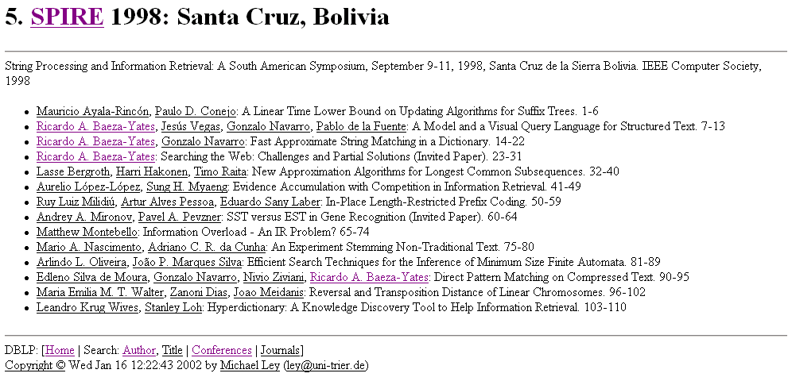

Slide 25
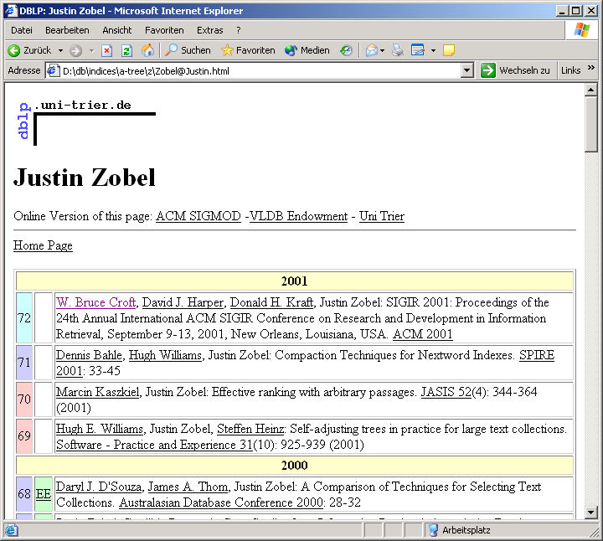

Slide 26
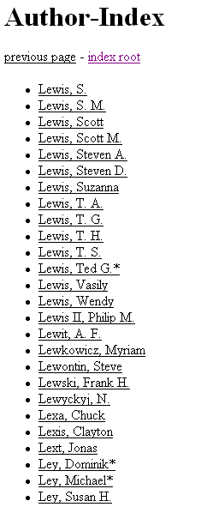
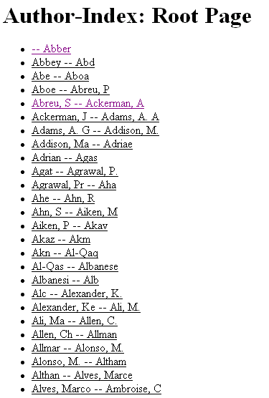
…
…

Slide 27
TOC Parser / Generation of Person Pages
Parser
TOC_OUT
mkauthors
Person
Pages
TOCs

Slide 28
Mirrors
University of Trier had a slow internet connections
DBLP should have a high availability
Technique:
  transfer all TOCs + entry pages + TOC_OUT in a tar.gz file
  run mkauthors on the mirror

Slide 29
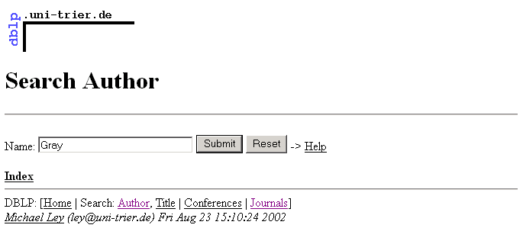
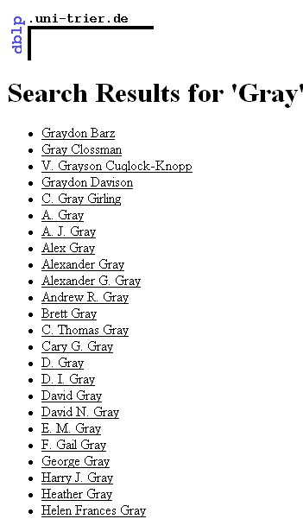
mkauthors
CGI
AUTHORS
author
…

Slide 30
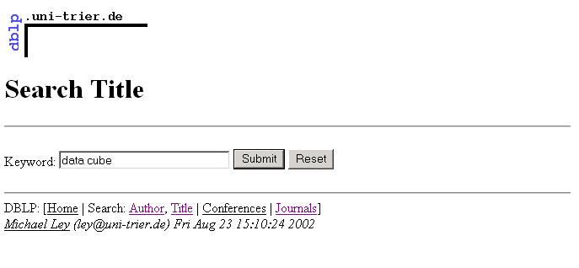
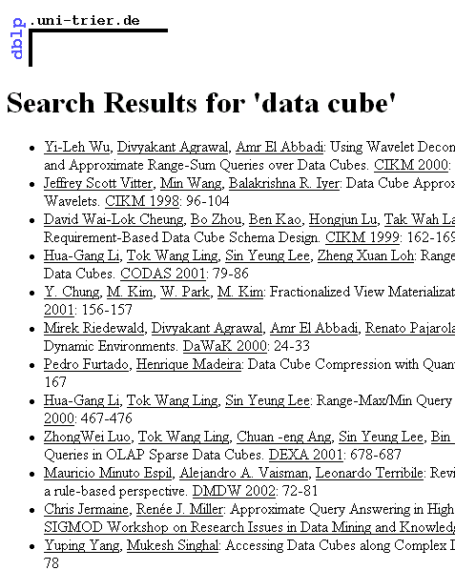
CGI
TOC_OUT
title

Slide 31
Bibliographic Records
citation linking, reviews, annotated bibliographies, …
assign an unique ID to each publication
make it accessible by this ID
store the information in classical bibliograhic records

Slide 32
Bibliographic Records
You may download them from
http://dblp.uni-trier.de/xml/
(uncompressed ~120MByte)
Simple DTD
Idea: BibTeX++ in XML syntax
Examples …

Slide 33
<article key="journals/wi/OberweisS91">
<author>Andreas Oberweis</author>
<author>Wolffried Stucky</author>
<title>Die Behandlung von Ausnahmen in
Software-Systemen: Eine
Literatur&uuml;bersicht.</title>
<pages>492-502</pages>
<year>1991</year>
<volume>33</volume>
<journal>Wirtschaftsinformatik</journal>
<number>6</number>
<url>db/journals/wi/wi33.html#OberweisS91
</url>
</article>

Slide 34
<inproceedings key="conf/gi/OberweisPS01">
<author>Andreas Oberweis</author>
<author>Oliver Paulzen</author>
<author>Hagen J. Sexauer</author>
<title>Ein wissensbasiertes Vorgehensmodell
zur Gestaltung von CRM-Systemen.</title>
<pages>429-436</pages>
<year>2001</year>
<booktitle>GI Jahrestagung (1)</booktitle>
<url>db/conf/gi/gi2001-1.html#OberweisPS01
</url>
</inproceedings>

Slide 35
<inproceedings key="conf/er/JaeschkeOS93">
<author>Peter Jaeschke</author>
<author>Andreas Oberweis</author>
<author>Wolffried Stucky</author>
<title>Extending ER Model Clustering by
Relationship Clustering.</title>
<pages>451-462</pages>
<year>1993</year>
<booktitle>ER</booktitle>
<url>db/conf/er/er93.html#JaeschkeOS93</url>
<crossref>conf/er/93</crossref>
<cdrom>er93/ER93-P447.pdf</cdrom>
<ee>db/conf/er/JaeschkeOS93.html</ee>

Slide 36
<cite label="CaJA89">conf/er/CarlsonJA89</cite>
<cite label="Chen76">journals/tods/Chen76</cite>
<cite label="FeMi86">journals/cj/FeldmanM86</cite>
<cite label="Mart89">...</cite>
<cite label="Mist91">...</cite>
<cite label="RaSt92">conf/er/RauhS92</cite>
<cite label="ScSt83">...</cite>
<cite label="ScSW79">conf/er/ScheuermannSW79</cite>
<cite label="TeYF86">journals/csur/TeoreyYF86</cite>
<cite label="TWBK89">journals/cacm/TeoreyWBK89</cite>
</inproceedings>

Slide 37
<proceedings key="conf/er/93">
<editor>Ramez Elmasri</editor>
<editor>Vram Kouramajian</editor>
<editor>Bernhard Thalheim</editor>
<title>Entity-Relationship Approach - ER'93,
12th International Conference on the
Entity-Relationship Approach, Arlington,
Texas, USA, December 15-17, 1993,
Proceedings</title>
<booktitle>ER</booktitle>
<series href="db/journals/lncs.html">Lecture
Notes in Computer Science</series>
<volume>823</volume>
<publisher>Springer</publisher>
<year>1994</year>
<isbn>3-540-58217-7</isbn>
<url>db/conf/er/er93.html</url>
</proceedings>

Slide 38
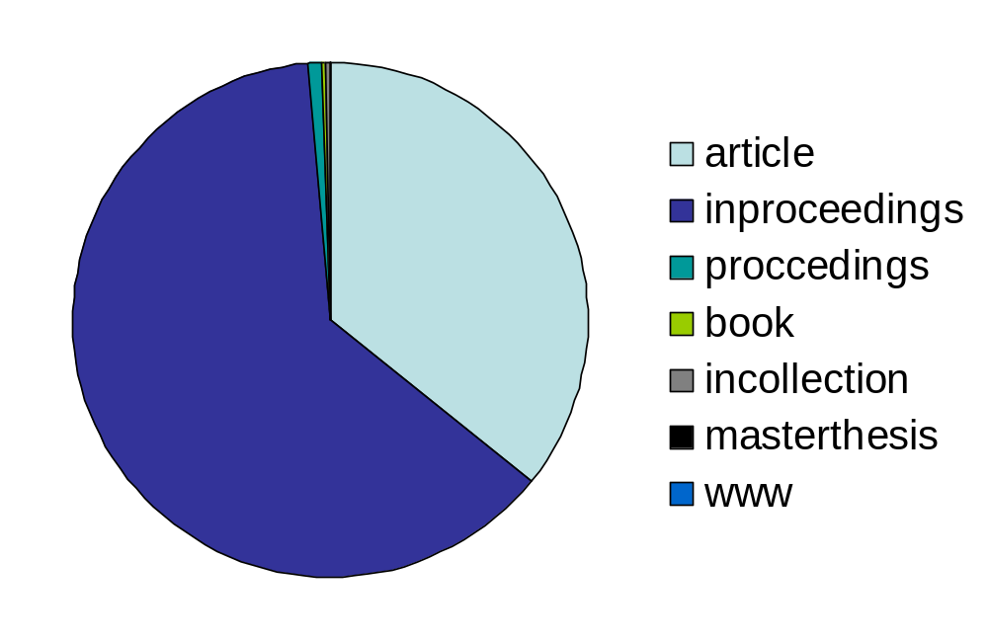
Publication Types

Slide 39
XML Parser / Generation of Person Pages
Parser
TOC_OUT
mkauthors
Person
Pages
XML-Records

Slide 40
Tables of Contents, …
BibTeX(xml)
BHT
HTML
BibTeX(xml)
BibTeX(xml)
…
BibTeX(xml)

Slide 41
„Bibliography HyperText“ (BHT)
include mechanism (<cite key='…' style='…'>)
several addtional tags: <logo>, <footer>, <ref href="…">, …
HTML

Slide 42
<html><head><title>25. SIGIR 2002: Tampere, Finland</title></head>
<body bgcolor="#ffffff" text="#000000" link="#000000"><logo style="sigir">
<h1>25. <ref href="db/conf/sigir/index.html">SIGIR</ref> 2002: Tampere,
Finland</h1><hr>
<cite key="conf/sigir/2002"><cite key="conf/sigir/2002" style="bibtex">
<center>
<img alt="SIGIR 2002" src="sigir2002logo.gif" border=0 width=108 height=94>
</center>
<ul>
<li><cite key="conf/sigir/Rijsbergen02" style=ee>
</ul>
<h2>Web Information Retrieval</h2>
<ul>
<li><cite key="conf/sigir/AnhM02" style=ee>
<li><cite key="conf/sigir/ParkPGK02" style=ee>
<li><cite key="conf/sigir/SiC02" style=ee>
<li><cite key="conf/sigir/KraaijWH02" style=ee>
</ul>
<h2>Information Retrieval Theory</h2> …

Slide 43
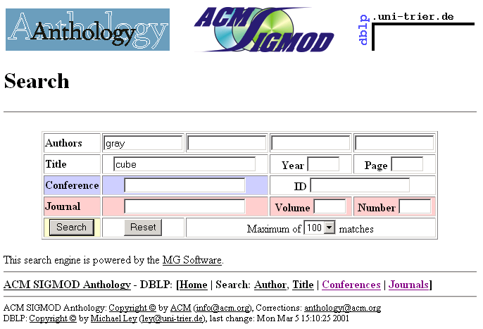

Slide 44
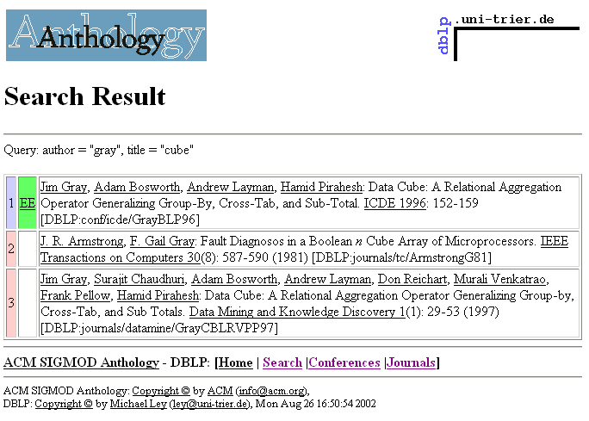

Slide 45
„Advanced Search“: MG
„Managing Gigabytes“ Software by Witten, Moffat, Bell
DBLP XML Records →MG Documents
Filter: matching terms in the required field

Slide 46
DBLP Architecture
Entry Pages
Advanced
Search
Person
Search
„Streams“:
Conference Series,
Journals
generated
answers
Person Pages
Tables of Content (TOC)

Slide 47
Entering Data
Students
BibTeX
…
BibTeX
mkhtml
BHT
WWW, E-Mail
wrapper

Slide 48
Anthology: Offline Search
Simple search engine for all standard platforms → Java Applet (Java 1.0)
Only author search
Applet reads simple tree data structure from files:

Slide 49
…
curran,john H
cutting,d
czarnecki,h
dabbaghc
dagmar br
daigr
dale ro
dambr
dan cart
dan sm
dang,z
daniel d. fu
daniel j. bur
daniel mend
daniel sa
daniela mer
dannenberg,c
darad
…
…
Mann,Robert I.
Mann,Sally Fahrenholz-
Mann,Samuel
Mann,Stefan
Mann,Stephen
…
Mann-Ho Lee
Mann-May Yau
Manna,I.
Manna,M. La
Manna,Serena La
Manna,Zohar
Mannai,Dhamir N.
Mannarino,Gabriela Susana
Mannava,Phanindra K.
Manne,Fredrik
Manne,Srilatha
Manneback,Pierre
…
root:
separators
leaves: names
(permutations
of name parts)

Slide 50
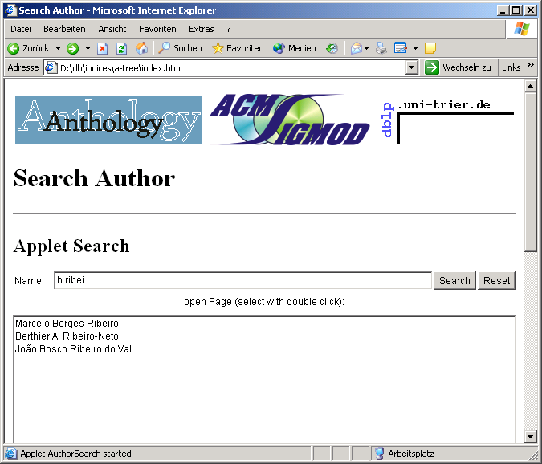

Slide 51
Anthology: Full Text Search
Acrobat „catalog“: index construction
„capture“: OCR for scanned texts
manual entry of title fields was necessary
  insufficient software support by Adobe
Acrobat Reader „with search“
  not available for Linux

Slide 52
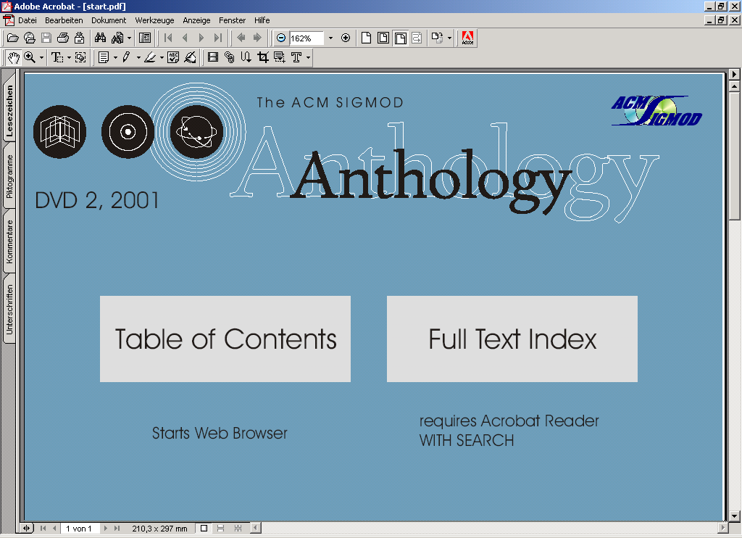

Slide 53
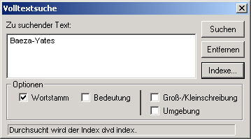

Slide 54
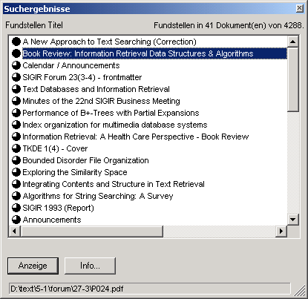

Slide 55
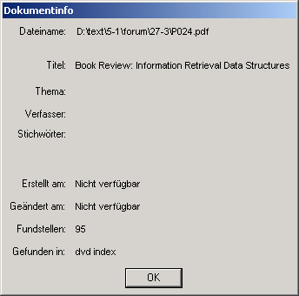

Slide 56
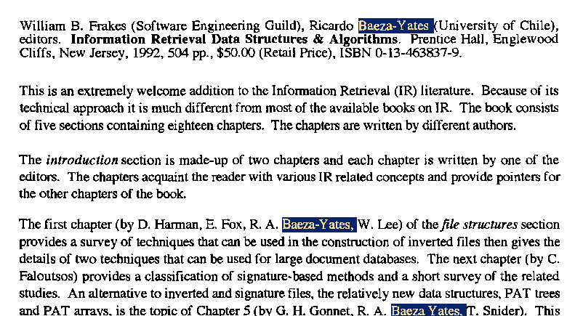

Slide 57
3. Perspectives &
Research Issues
Funding & collaborations
Person Names
DBLP Browser
Visualization
Classification / Clustering

Slide 58
Informatics Portal
DBLP will be a central part of a larger Informatics Portal
Other parts:
  CompuScience (FIZ Karlsruhe)
  Collection of CS Bibliographies (Achilles/Vollmer, Karlsruhe)
  LeaBib (Mayr, Munich)

Slide 59
Informatics Portal (2)
Funded by the German Federal Ministry of Education and Research, 3 years
In Cooperation with the „Gesellschaft für Informatik“ (German Computer Society)
2 open positions at Trier: service+research

Slide 60
Additional Contents …
complete coverage of LNCS
more ACM & IEEE publications
cooperation with IFIP, Usenix, …
cooperation with the libraries at Dagstuhl & Max-Planck-Institut für Informatik (Saarbrücken)
several German series (LNI,IA,IFB…)

Slide 61
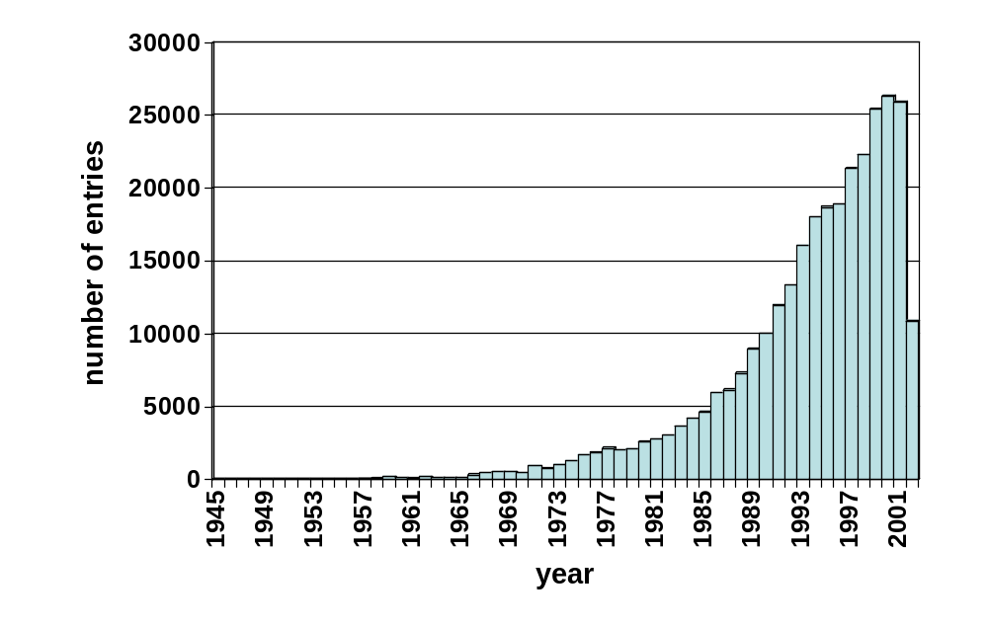
Number of records by publication year
(24 August 2002)

Slide 62
Challenge: How to manage the exponential growth of (computer) science publications ?
maintenance problem
„lost in publication space“

Slide 63
Person Names
widely accepted method to identify persons
names may not be unique
a person may change her/his name (marriage, emigration to other cultural environment)
variations of person names …

Slide 64
abbreviations: Jeffrey D. Ullman, J. D. Ullman, J. Ullman, Jeff Ullman, …
nicknames: Michael / Mike, William / Bill, Joseph / Joe
permutations: Liu Bin / Bin Liu
different transcriptions: Andrei / Andrej / Andrey
accents: Stephane / Stéphane
umlauts: Muller / Müller / Mueller

Slide 65
ligatures: Weiß / Weiss, Åström / Aastrom
case: Al-A’Ali / Al-A’ali
hyphens: Hans-Peter / Hans Peter
composition: MaoLin / Mao Lin, Kenichi / Ken-ichi / Ken’ichi
postfixes: Karel Culik II, Jr. / Sr.
typos

Slide 66
Person Names: Problems
there should be a 1:1 mapping between persons and person pages
how to search persons best ?
how to normalize different spellings ?
name normalization costs more
than 60% of our time …

Slide 67
Person Name Normalization
for each new entry we try to locate the authors/editors in the existing collection
if spellings differ, but we are confident that they are variations of the same person‘s name → make them equal
write out most parts of the name
person‘s perferred spelling ?

Slide 68
for persons with many publications the name spelling usually converges to a stable & correct state
for persons with a few known publications it is more likely that there are duplicate person pages, incorrect or incomplete spellings

Slide 69
Heuristics in the decision process
coauthor relationship gives strong indications for the identity of persons
streams (journals/conference series): condensation points for communities, weaker indication
same keywords in titles
time frame ?
a lot of background knowledge …

Slide 70
Wanted: Tool to make DBLP maintenance more efficient
specialized weight functions for the name normalization problem
  query: new entry = list of names, title, publication stream, year, …
„DBLP browser“: framework for experiments

Slide 71
DBLP Browser: Roles
maintenance tool
bibliographic tool for users of DBLP
  composition of reference lists
  export in popular formats like BibTeX
platform for experiments in visualization (SemIPort project …)

Slide 72
DBLP Browser
main memory IR system
  compressed representation of the bibliographic records
convenient graphical user interface
Java / Swing
first prototype implemented

Slide 73
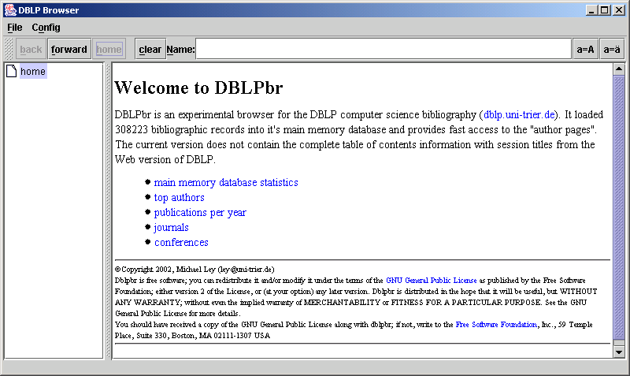

Slide 74
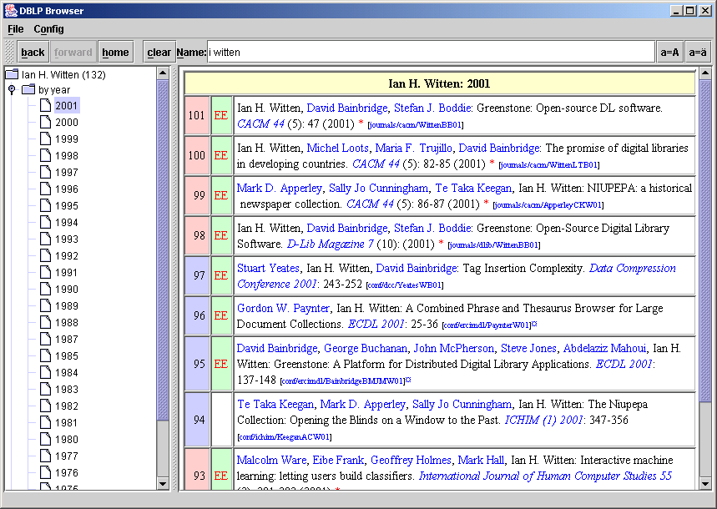

Slide 75
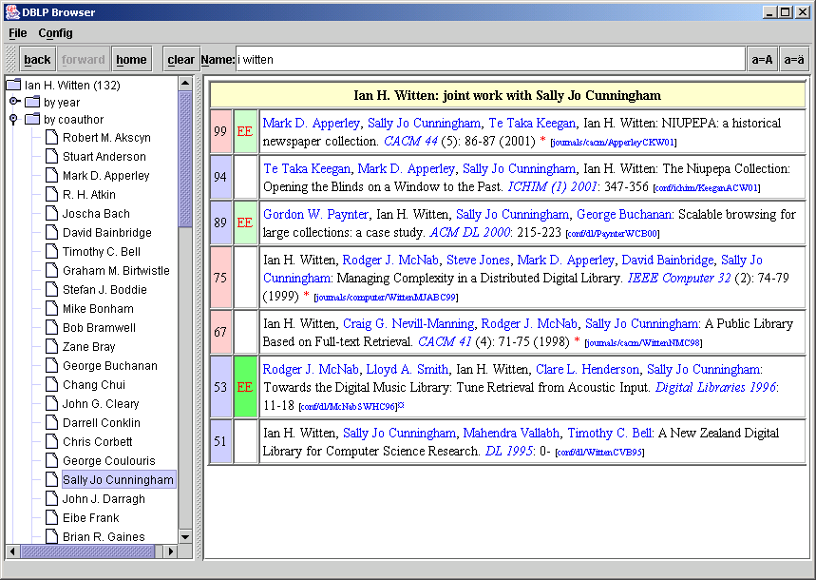

Slide 76
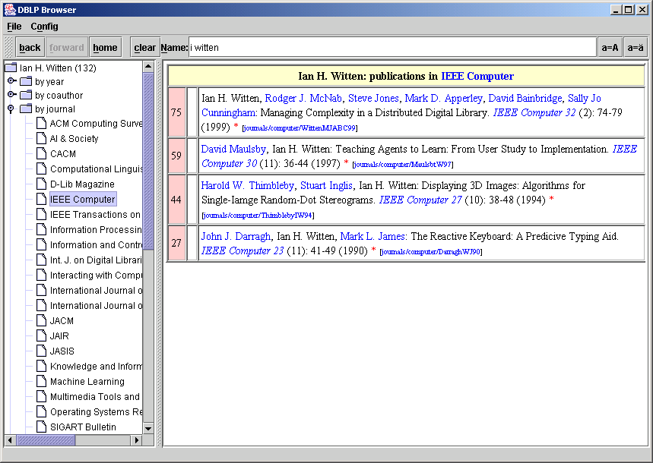

Slide 77
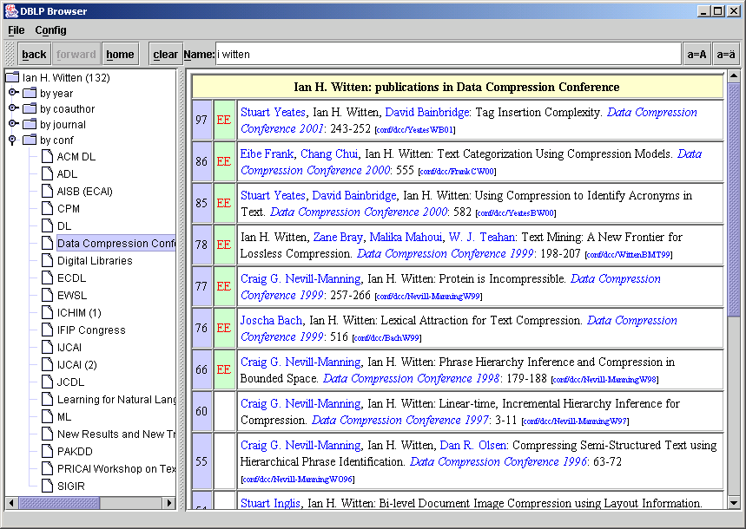

Slide 78
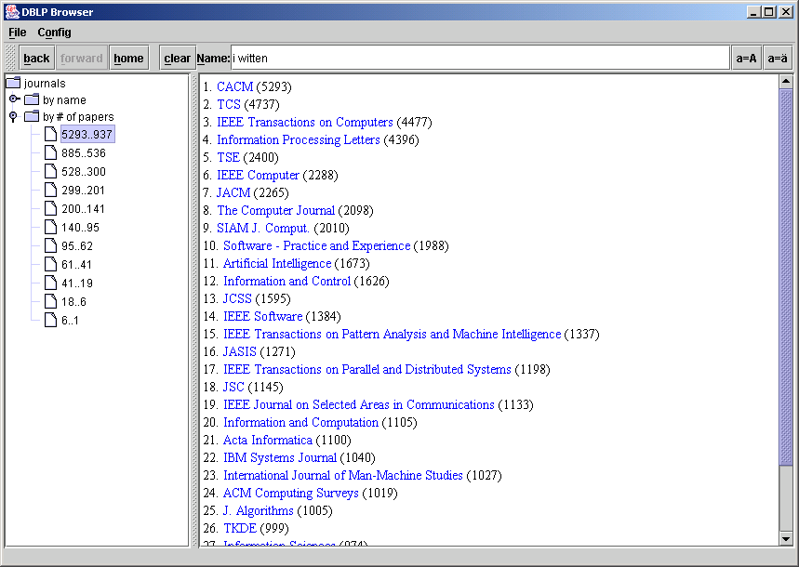

Slide 79
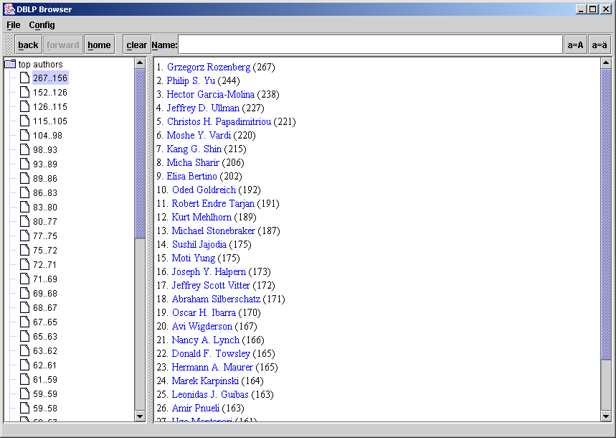

Slide 80
<article key="journals/ai/SchreyeBV89">
<author>Danny De Schreye</author>
<author>Maurice Bruynooghe</author>
<author>Kristof Verschaetse</author>
<title>On the Existence of Nonterminating Queries for a Restricted Class of PROLOG-Clauses.</title>
<pages>237-248</pages>
<year>1989</year>
<volume>41</volume>
<journal>Artificial Intelligence</journal>
<number>2</number>
<url>db/journals/ai/ai41.html#SchreyeBV89</url>
</article>
…

Slide 81
Representation of <title>-Fields:
construct canonical Huffman codes on word level [MG-Book]
degree of tree-nodes: 213 (0x2a-0xff)
lexicon: 3-in-4 front coding
Publications are sorted by journal/booktitle, year

Slide 82
…
7Comprehending32sibility5-ons0sion
2Compress21ibility3+n3onless
6Compressions3,ve2.lets2or
5Compressors/-ise2+d2s
4Comprising/5omisability3,ed4s
6Compromising0+r..sing.ter
2Compters0,ur/-ing/on
2Comptuer.4uatational1-ion4al
5Compuations20tional//iting/log
4Compulsory/,nd0.ting/s
0Comput03abilities2-les3y
7Computacional1-ion4,al1ting
7Computationai6.lism5,el4ons
…
Lexicon of
title words
0=‘*‘, 1=‘+‘, 2=',', 3='-',
4='.', 5='/', 6='0', 7='1', …

Slide 83
Lexicon: title words
<article key="journals/ai/SchreyeBV89">
<author>Danny De Schreye</author>
<author>Maurice Bruynooghe</author>
<author>Kristof Verschaetse</author>
<title>c₁c₂c₃ ...</title>
<pages>237-248</pages>
…
</article>
…

Slide 84
Representation of <author>- and <editor>-Fields:
construct list of all persons
sort them by number of publications
add inverted lists (publication numbers) to all persons
Peter Smith 17 36 1003 7790 8800
Johanna Mayer 36 2077 9002
…

Slide 85
Representation of inverted indexes
1
m
n
m
line1
line2
line3
…
line n
line 1 line 2 line 3 … line n
1
…
use d-gaps [MG-book]
variable-byte coding (base 111 numbers, ≈ 7bit value + last byte flag) [Scholer et al., SIGIR 2002]
n

Slide 86
…
Alberto H. F. Laender)s»™"bê~5º"žÙ\ü¢"@Í&ñ¤$¥"ð8ì?Øµ\­"ÜÖà·$œ¤
"iï$-¯"c—UÚLÌ"?¨"<°#Há"nÆWÕh·â‘#:Ò"=£’
Melvin A. Breuer)#ˆÈ"j¥%ù"û"ß"—"–÷"W¯"0à"†ò$È"Â¶£"ž"n·\Û*Û&ª´&·í$Ÿ
"Ò$¸¸Âö&»#-™"²#½"¼¹ø"'ÁyÅ&þFÌ
Jean-Louis Lassez)0Ñ‰×qØ¹$4Ò=ÆgÅ";´áM¹5Ä±#R÷Ò"Í#RÅ#&è#ø"ký¯
-Â*˜"ô"·q™)¡)Î.­]ò8ßfŸ"Ì(§$;¬$õGí"æ#¨"aÒ’
Weiyi Meng)P¾1à:¼¶#^ž½Ê"5ÉâEî‘8¸®#Ú&ø%Xž#×¡"ÇÔƒô~ú‘$O¨}Ì²QÜ
‹Ã‹©#uÚ"‹û#¯-Ÿ$ `´GÉ2¯JÑ'°Vå
Walter L. Ruzzo)"SšŽ´“åO«V©r¸ž$4­'›"m—$Æ%jà"<Æ&Ö~òHö#¤¦#ë"Ÿ®
%'©Õ' µƒÝ%°À?ø"É‘$§ÅñçQÚš"˜ú
James E. Rumbaugh)o´#%ñ#Í$D®&DãQõ%\ï¦Ú¦¦©¦›žššš›œ¢¢š˜œš›™™
›#$žö§" ËÅ&G«"1ø
Abdul Sattar)8éº‚Ó5ò‘£’×ˆ”®À »–"S¤´>ÒÜa›&&¸0Ö=Ú0Êl—"mØ#F¹pë#yÃ
=š? Jª÷•™$,—%›Iì©Ç²
…

Slide 87
Lexicon: title words
Person table
<article key="journals/ai/SchreyeBV89">
<author>a₁</author> <author>a₂</author>
<author>a₃</author> <title>c₁c₂c₃ ...</title>
<pages>237-248</pages>
<journal>Artificial Intelligence</journal>
…
</article>
…

Slide 88
Representation of <journal>- and <booktitle>-Fields:
construct lists of all journals and booktitles
add position of first publication with this journal/booktitle and count
Artificial Intelligence 5000 603
TODS 7890 400
…

Slide 89
331
10509
CACM)#^ãPÜ
TCS)7I¢KÛ
IEEE Transactions on Computers),[žIµ
Information Processing Letters)/KàHÓ
TSE)89Ô6Ü
IEEE Computer)+ã5Ô
JACM)0|˜5½
The Computer Journal)8UÒ3ô
SIAM J. Comput.)5@­3œ
Software - Practice and Experience)6zÛ2õ
Artificial Intelligence)"‹Ê0˜
Information and Control)/Ž÷/Ø
JCSS)12Î/¹
IEEE Transactions on Pattern Analysis and Machine Intelligence),Ò.¤
…

Slide 90
Lexicon: title words
Person table
Journal table
Booktitle table
<article key="journals/ai/SchreyeBV89">
<author>a₁</author> <author>a₂</author>
<author>a₃</author> <title>c₁c₂c₃ ...</title>
<pages>237-248</pages> <journal>j</journal> <number>2</number>
<url>db/journals/ai/ai41.html#SchreyeBV89</url>
</article>
…

Slide 91
Representations of Paths: key, <ee>, <url>
conf
construct paths dictionary: bottom-up tree of path elemens
vldb
spire
sigir
…
Gray88
Ullman91

Slide 92
Lexicon: title words
Person table
Journal table
Booktitle table
paths dictionary
series table
publishers table
…
Av’SchreyeBV89)T½fùf:´föf*ÚñfL•fófìfNŸf3;föfHþl3Km)g#Ÿœuv Ypš¹’b“#û"“"+´
…
Ap₁SchreyeBV89Tl₁l₂…)gn₁n₂up₂Yypjvnb3a₁a₂a₃

Slide 93
DBLP Browser: Compression
XML-file (Sept 3, 2002) | 123328 KB
zip(XML-file) | 22100 KB
Compressed representation | 26664 KB
zip(compressed representation) | 14732 KB

Slide 94
DBLP (Browser): next step
search
visualization
BHT files, but standard cases should not require BHT files: extentsion of the BibTeX data model …

Slide 95
Extension of the BibTeX data model
stream
conference
periodical
crossref
cite
crossref
cite
volume
proceedings
pvolume
crossref
cite
crossref
cite
paper
inproceedings
article

Slide 96
<conference key=„conf/vldb/@“>
<title>Conference on Very Large Databases</title>
<booktitle>VLDB</booktitle>
<url>db/conf/vldb/index.html</url>
<toc>
…
<cite>conf/vldb/2002</cite>
…
<cite>conf/vldb/2001</cite>
…
</toc>
</conference>

Slide 97
User Interfaces for Bibliographic Collections
conventional wisdom: provide a good IR system
DBLP: browsing oriented interface + very simple search tools
Why is DBLP nervertheless used?

Slide 98
„…there was little comprehensive searching by faculty researchers because they worked within specialized forums where they could more efficiently find the materials they needed. This precluded comprehensive searching to identify an exhaustive set of materials in a wider variety of forums. […] They also used browsing to examine electronic announcements of conferences, and tables of contents of journals …“
[Lisa Covi, PhD thesis 1996]

Slide 99
Problems of the many search-oriented Web-Portals
How to query … ?
Description / characterization of the collection unknown

Slide 100
views – visualizations – diagrams
global characterizations of the collection (coarse navigation)
stream level diagrams
person page visualizations

Slide 101
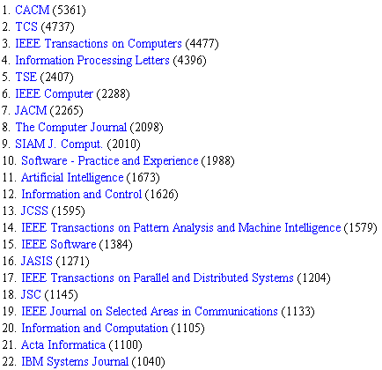
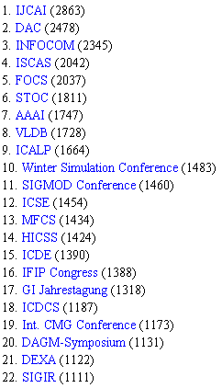
global characterizations …

Slide 102
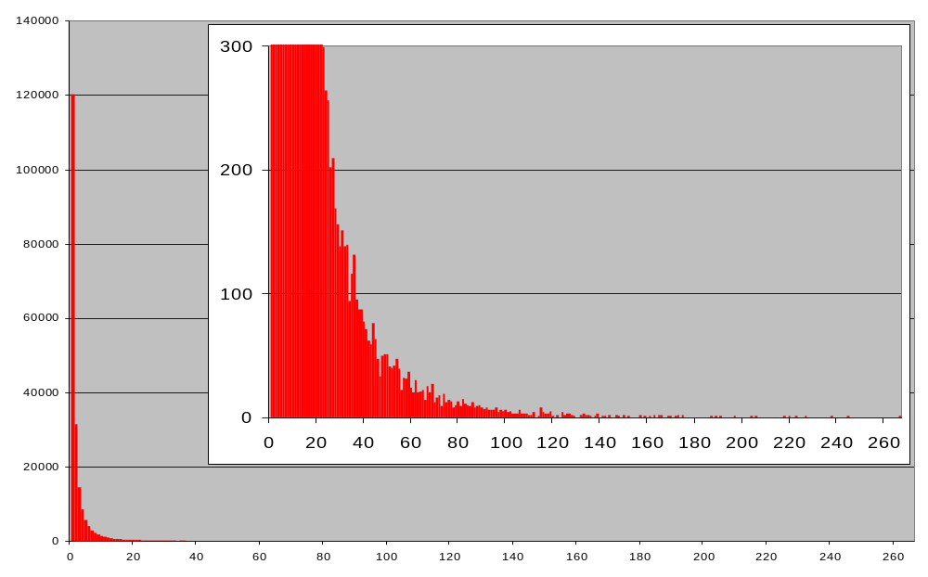
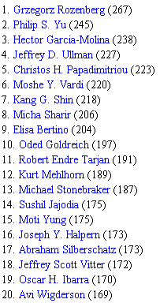
persons
number of publications

Slide 103
Classification
ACM CR System
  classifications only avalable for small subset of computer science literature
  often criticized as too inflexible / too coarse
intellectual classification (on the paper level) is too expensive

Slide 104
Clustering on stream level
related conferences or journals:
in which other streams did the authors of this stream publish most frequently ?
todo:
  what is „most frequently“?
  what is the neighborbood of a stream ?
  …

Slide 105
Publ.Key Cry.
JoC
SIAM J. Co.
IPL
CRYPTO
ACISP
FOCS
EUROCRYPT
ASIACRYPT
STOC
TCS
JCSS

Slide 106
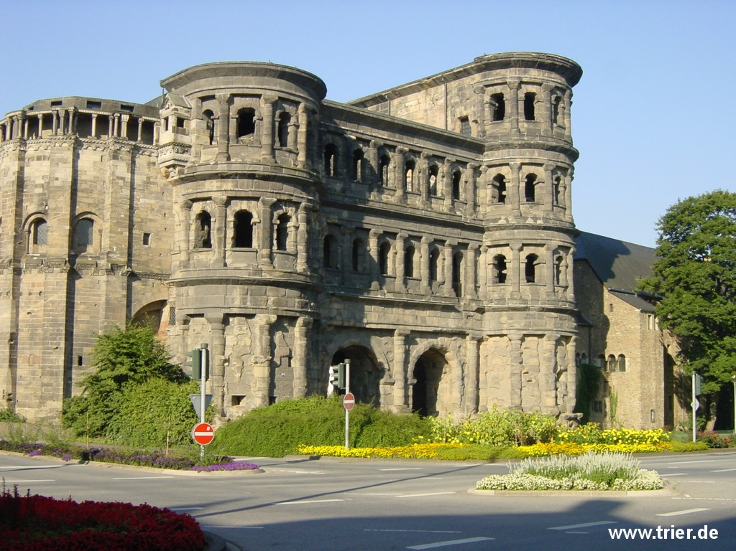
Thank you for your attention
„Porta Nigra“ – the most famous landmark of Trier

